Slide 1
NHS Forecasting Contest Kick-Off
Rich Wood, Nick Howlett, Alex Rabeau, Will Pearse
11th February 2026

Slide 2



Outline
Introduction from SPHERE-PPL Team
Contest, Timeline & Communication
Getting Started

Slide 3
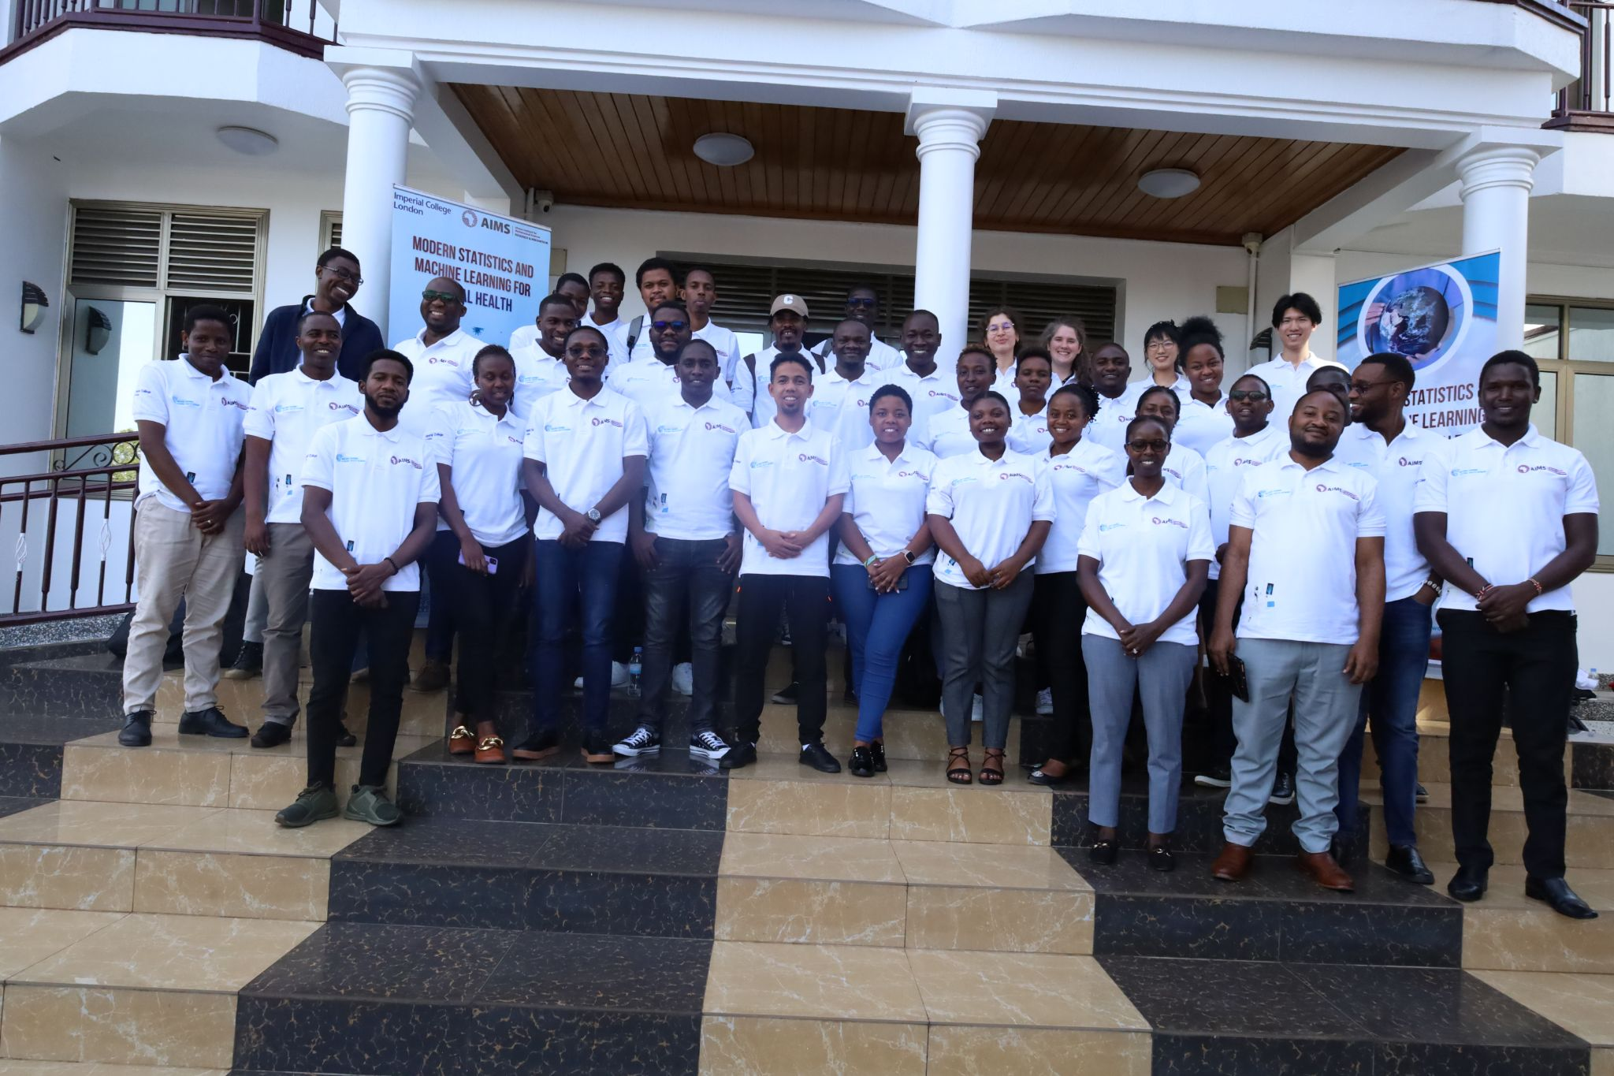
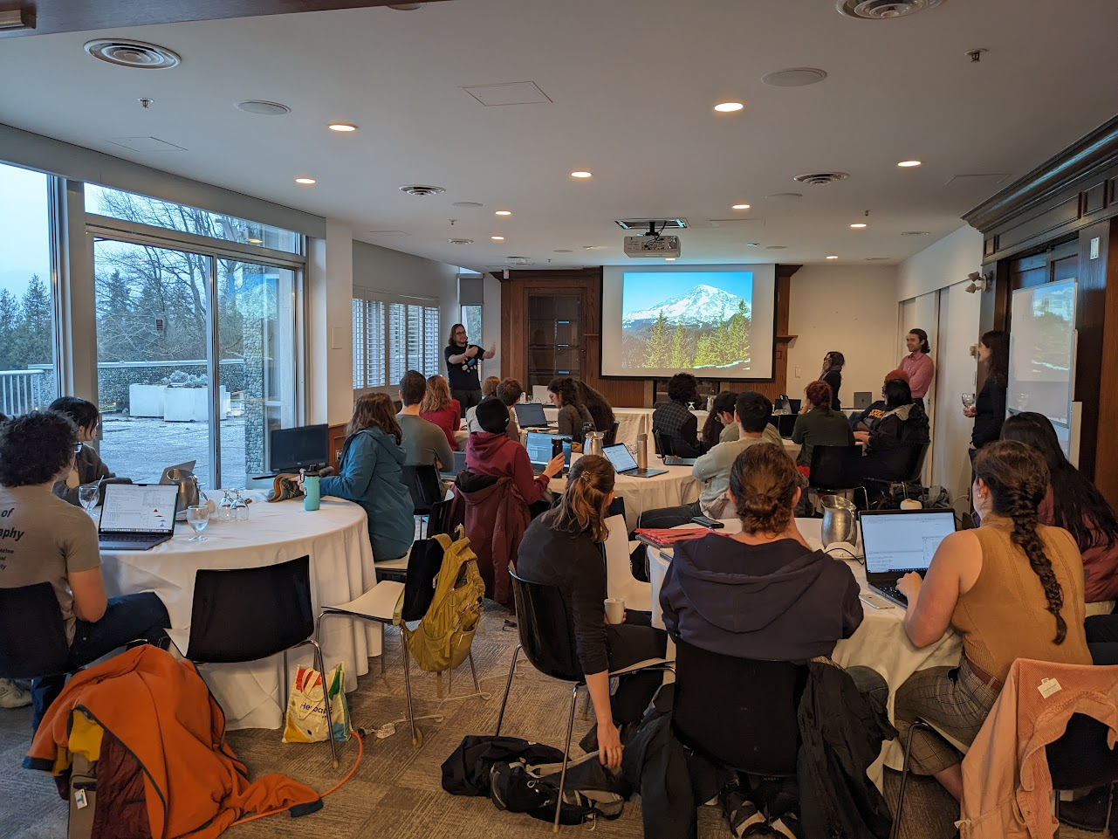

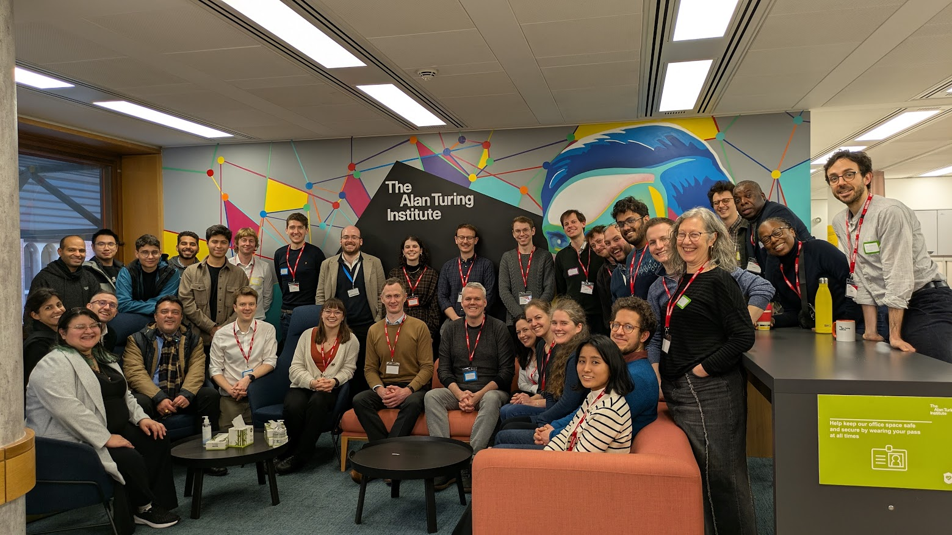
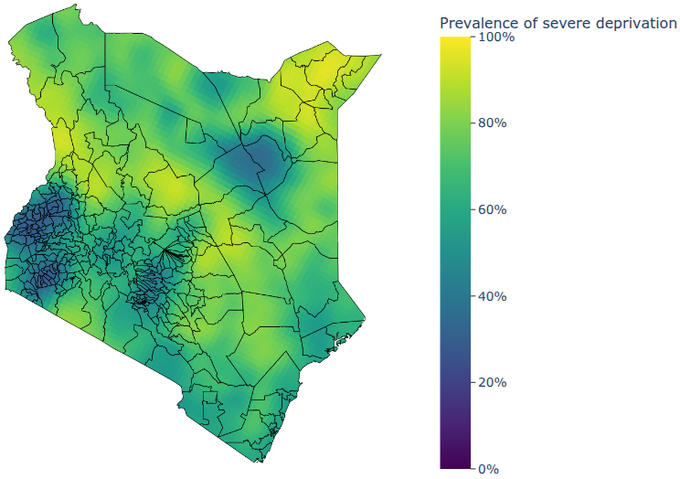
What is SPHERE-PPL doing?
Contests
Training
Networking
Research

Slide 4
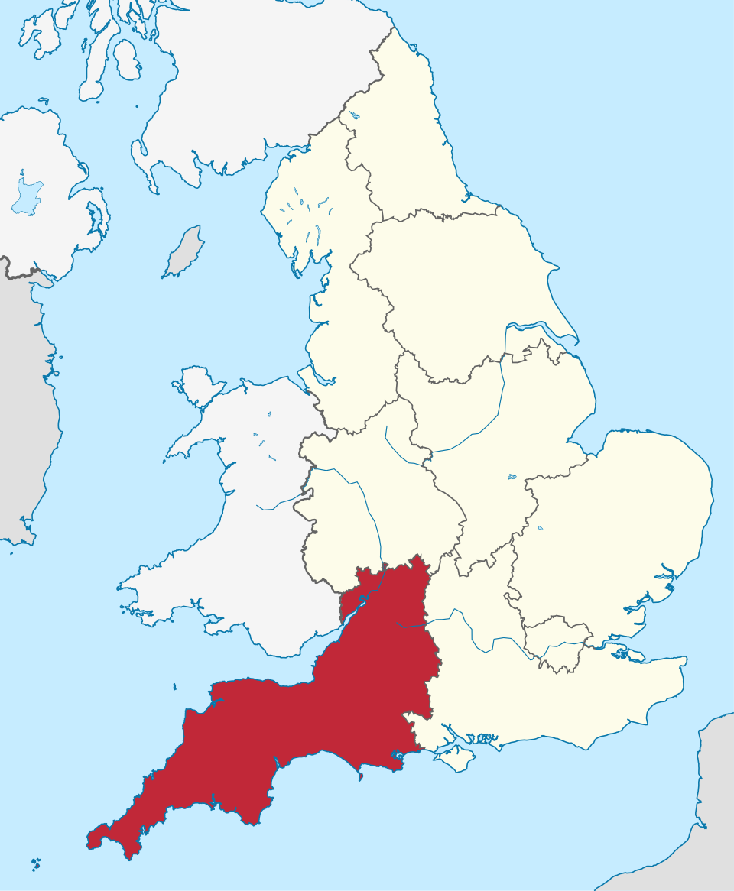
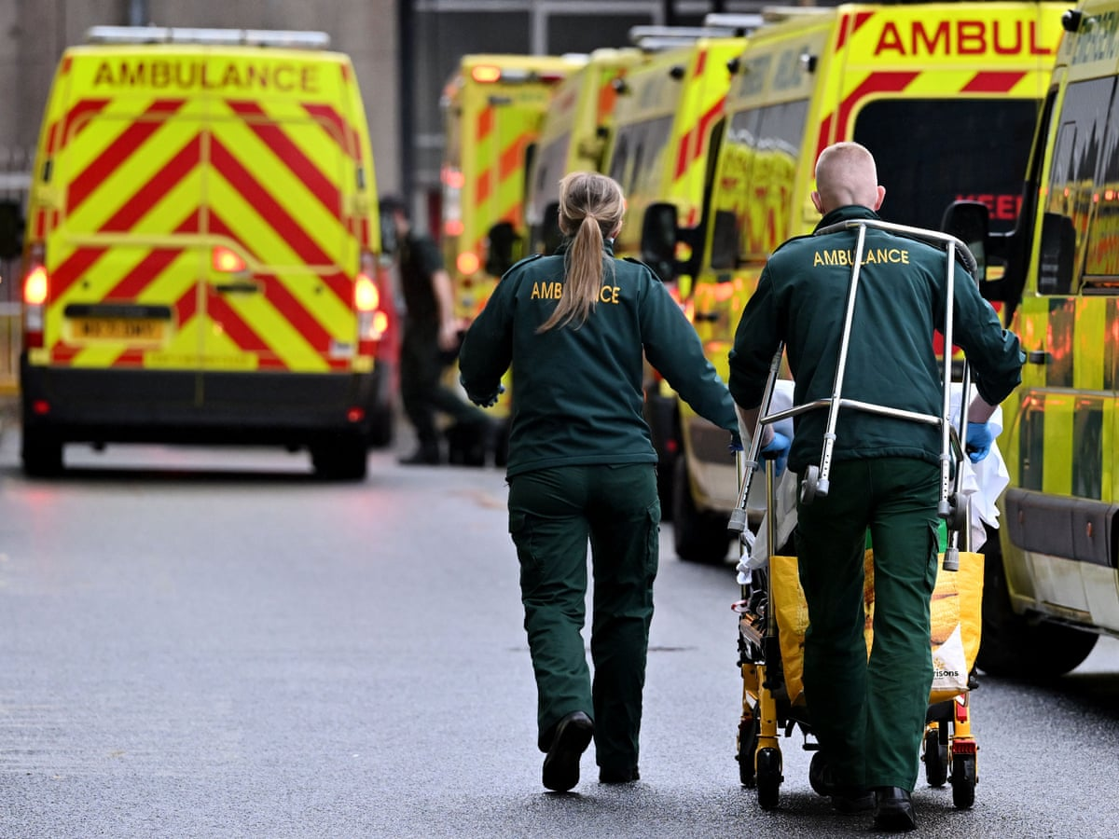
Introduction
Delays in admitting Emergency Department (ED) patients occur when no hospital beds are available after a decision to admit.
Each 4-hour delay increases the odds of 30-day mortality by 8%, equivalent to around 25 avoidable deaths per month in Bristol.

Slide 5
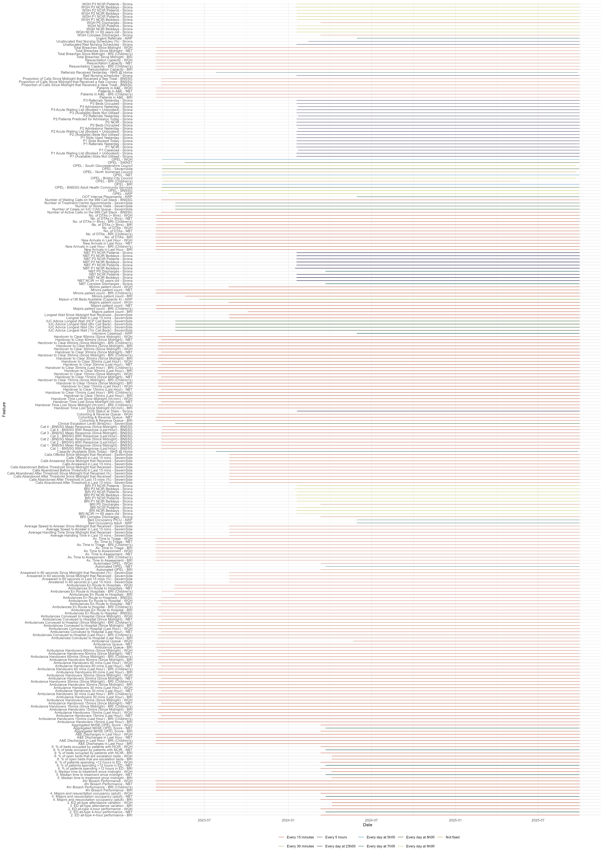
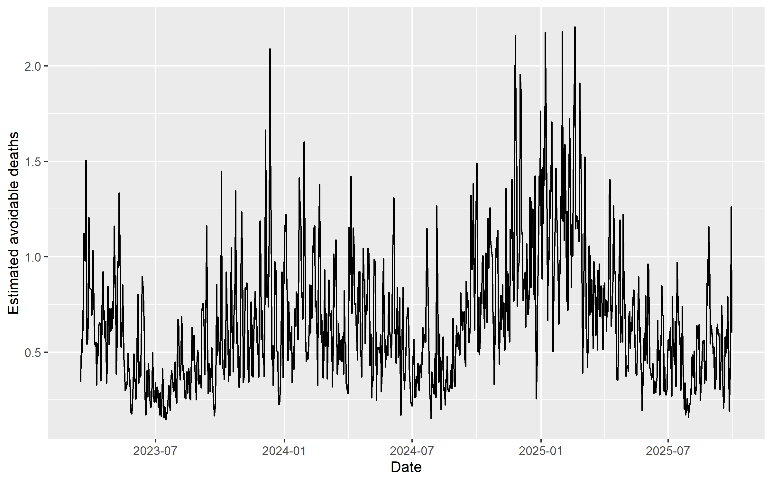
Data
Predictors:
220 variables
Hospital, ambulance, ED, primary care
Outcome variable: Estimated avoidable deaths
2.5 years of data (Mar 2023 – Sep 2025)
15 min – 24 hr temporal resolution

Slide 6
Contest Outputs
For this contest, we are looking to forecast Estimated Number of Avoidable Deaths across 1 - 10 day horizons. Forecasts and reports should be saved into the submission folder, matching the template found within.
The winning model will be implemented in the Bristol NHS system to provide early warnings and support pre-emptive management action.
All data used are real-world hospital data.

Slide 7

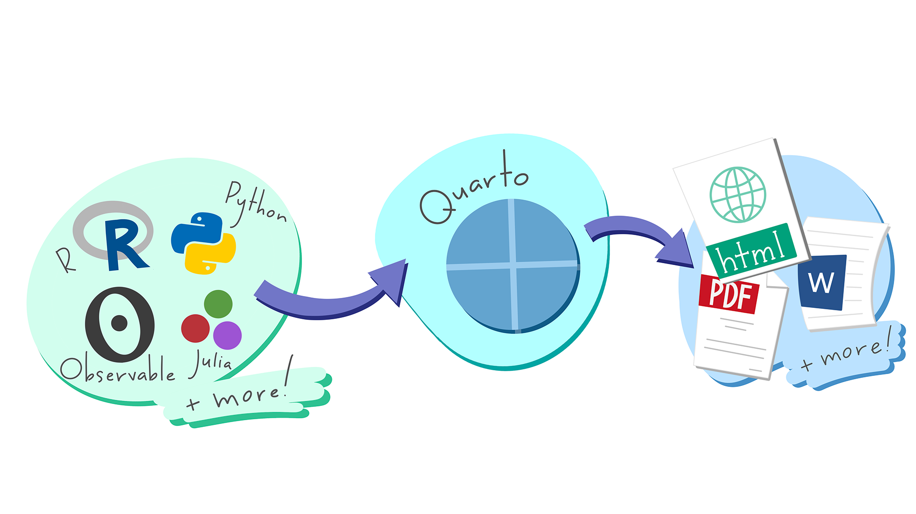
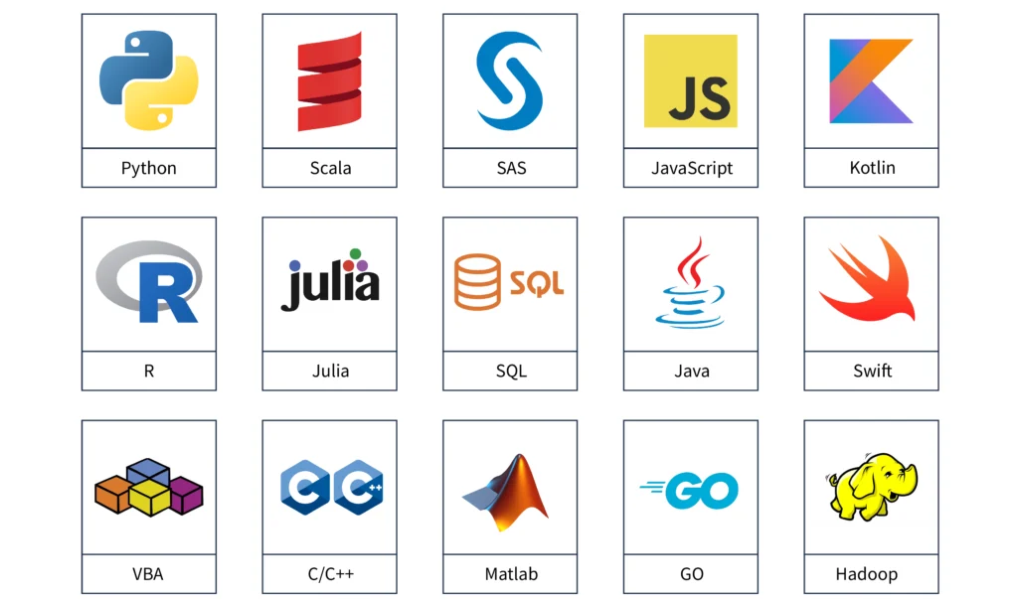
Contest Rules
The algorithm must be coded in either R or Python.
The computational running time to produce one set of 10-day forecasts must be under one hour on a standard desktop computer.
All entries must be loaded into a public Github repo.
All entries must include a max 1000 word report to accompany the forecast analyses. This can be as a separate PDF/hmtl or incorporated into a quarto/jupyter notebook.

Slide 8
Contest Winners
Awards will be given across two categories:
1. One prize will be given for the lowest MSE_1to5d.
2. One prize will be given for the lowest MSE_6to10d.
All winning teams will be assessed by the competition authors to ensure that the reported MSEs can be replicated with the submitted models, and to check all above restrictions are satisfied.
The winners will be selected by the SPHERE-PPL Team and will be invited to present their forecasts at the next Annual Meeting, with travel covered by the project.

Slide 9
Contest Timeline
11th February
Competition launch, including the release of the development dataset.
5th April 2026
Deadline for competitors to submit their final algorithms
6th April 2026
The assessment dataset is released
20th April 2026
Deadline for competitors to submit their forecasts.
8th May 2026
Winners announced

Slide 10

Communication
We will offer online drop-in sessions to answer any questions
We have a SPHERE-PPL Zulip group (akin to Teams or Slack) where we will be available to answer questions and interact with the community.
Please also use it for communicating within your own teams!
Join Here!

Slide 11
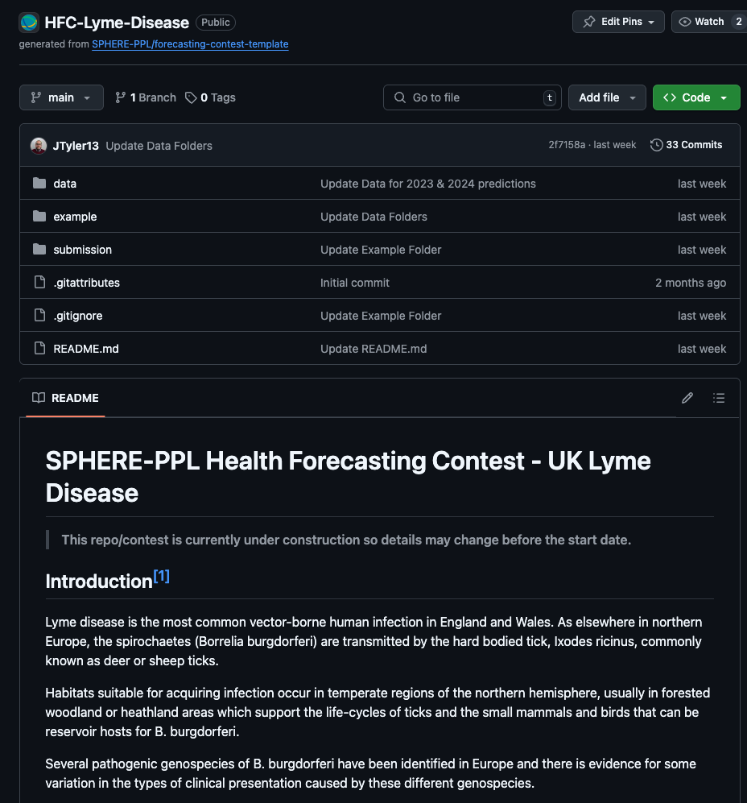
Getting Started
Main Link: NHS Forecasting Contest
Resources
Overview & Quick-Start Videos
Example Contest – Mpox

Slide 12
Thanks For Joining!
Get more information at our website: www.sphere-ppl.org
Email us at: info@sphere-ppl.org

